Slide 1
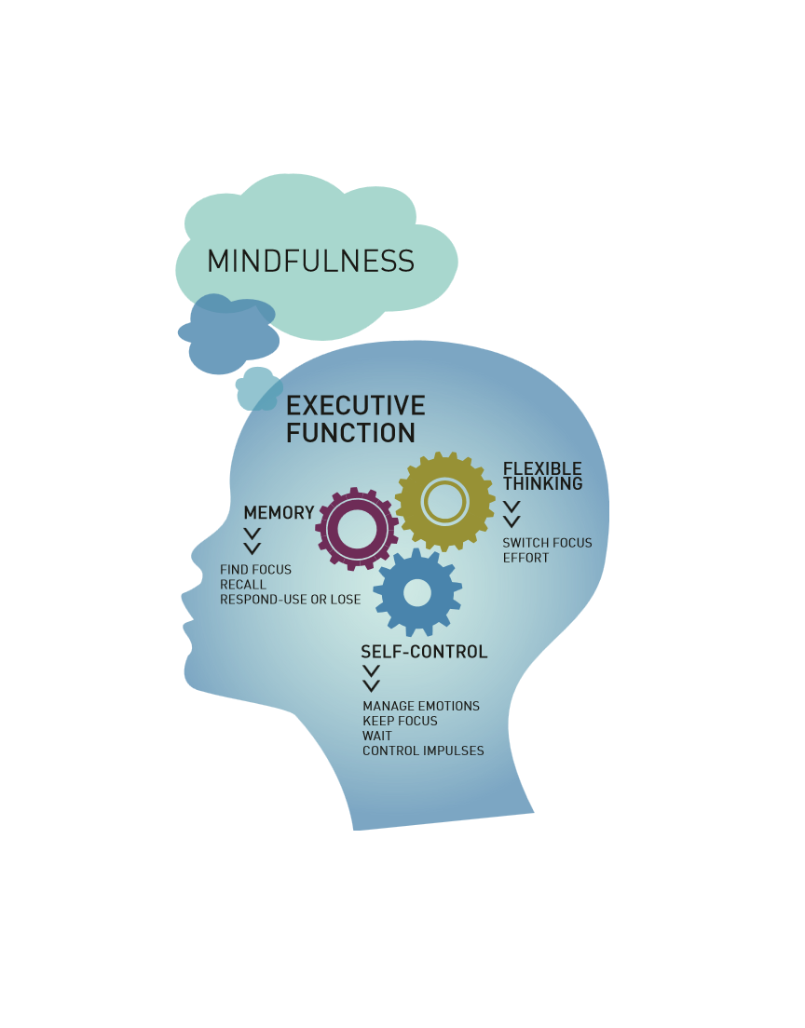
A Play Date with Jesus

Slide 2
Using the joy of
P
L
A
Y
in developmentally appropriate faith formation with young children

Slide 3
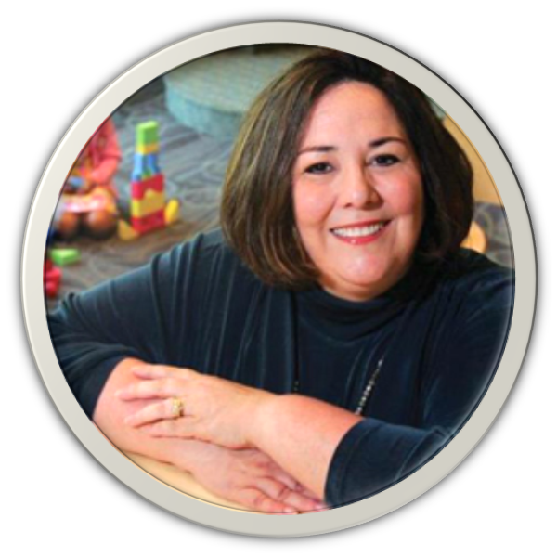
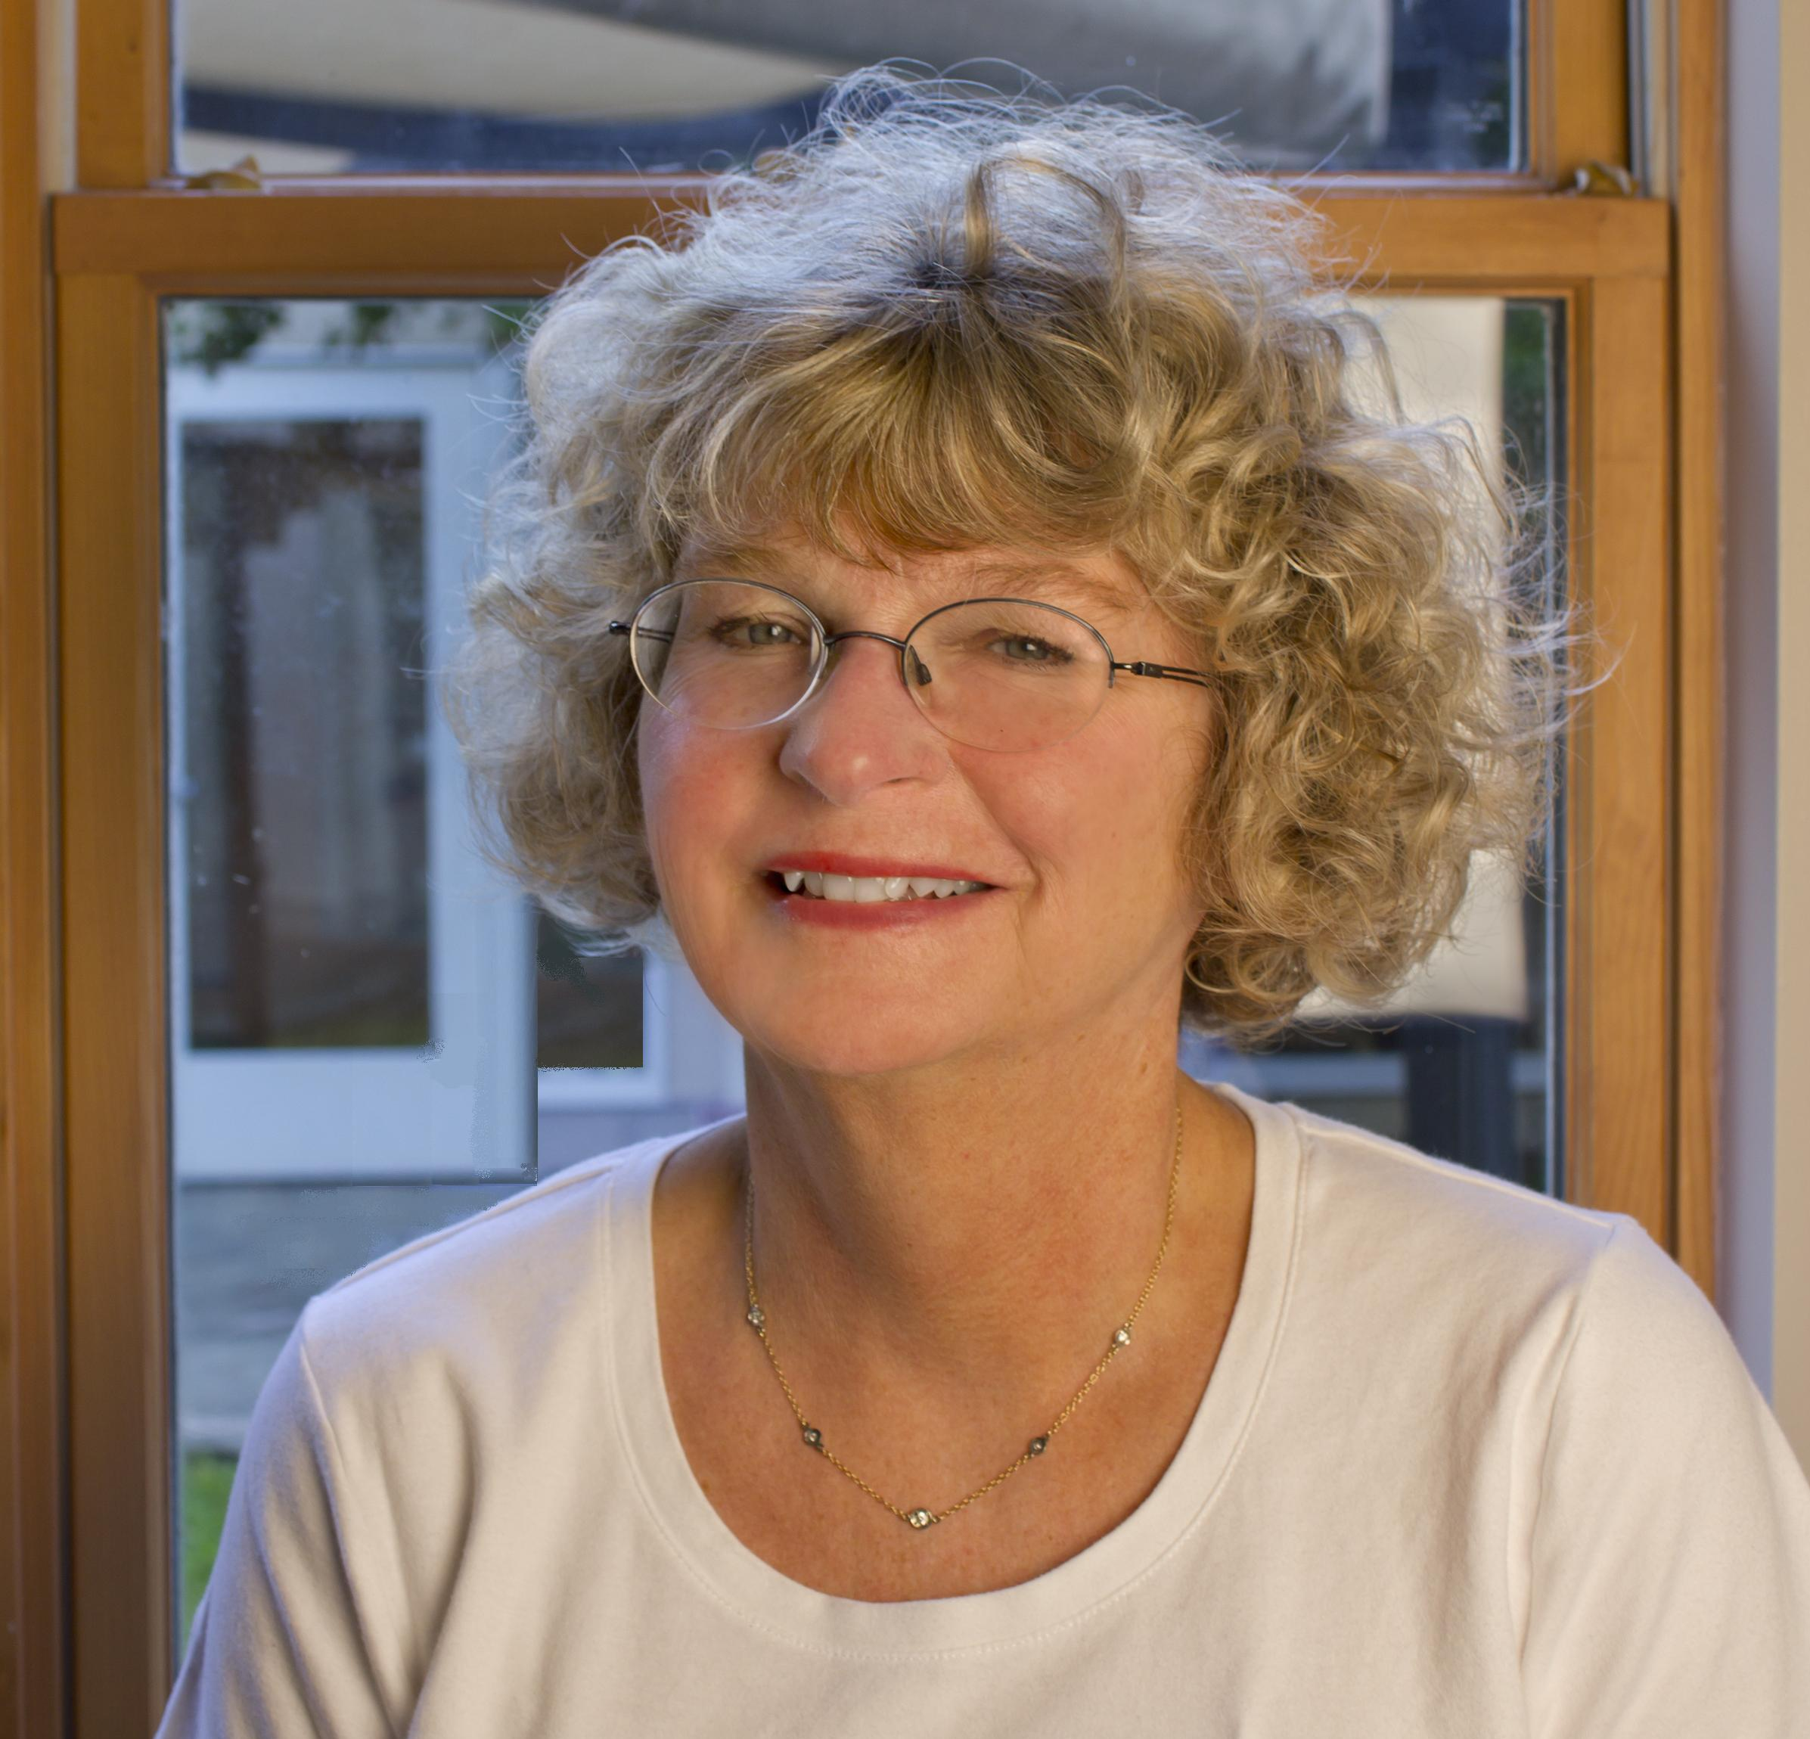
MEET THE PRESENTERS
Dr. Shauna Adams Ed.D.
Debbie Poppaw

Slide 4
MEET THE AUDIENCE

Slide 5
LEARNING OBJECTIVES:
Discover play scenarios that can allow young children to explore how to serve those in need as Jesus did.
Identify materials and create playscapes that share the joy in developing a relationship with God.

Slide 6
SCIENCE OF FAITH FORMATION
Faith formation occurs within the development of the whole child with one domain of development overlapping with and influencing the others.

Slide 7
Experience Expectant Systems
The Brain “Expects” Experience to Tunes
its Neural Circuitry
Childhood experiences-Hearing language, getting a hug, playing with objects, imitating motor patterns- alters brain connections, strengthening some and pruning others, When experience is absent, the pruning process may speed up, slowing the growth of brain connections

Slide 8
SCIENCE OF FAITH FORMATION
Faith formation occurs within the development of the whole child with one domain of development overlapping with and influencing the others.

Slide 9
BRAIN DEVELOPMENT &
SOCIAL-EMOTIONAL DEVELOPMENT

Slide 10
IMPACT OF FEAR & TOXIC STRESS
ON BRAIN DEVELOPMENT
FEAR & FLIGHT
Fear and pleasure (goodness & peace) build strong lasting connections in the brain

Slide 11
COMMITMENTS:
Provide experiences that engage children with God in a positive and long lasting manner
Honor God

Slide 12
OUR FAITH FORMATION JOURNEY
SUPPORT ALL AREAS
OF LEARNING
DEVELOPMENTALLY APPROPRIATE CONTENT
STAGING THE ENVIRONMENT

Slide 13
FAITH FORMATION JOURNEY
STARTS AT HOME
FAITH COMMUNITY
.

Slide 14
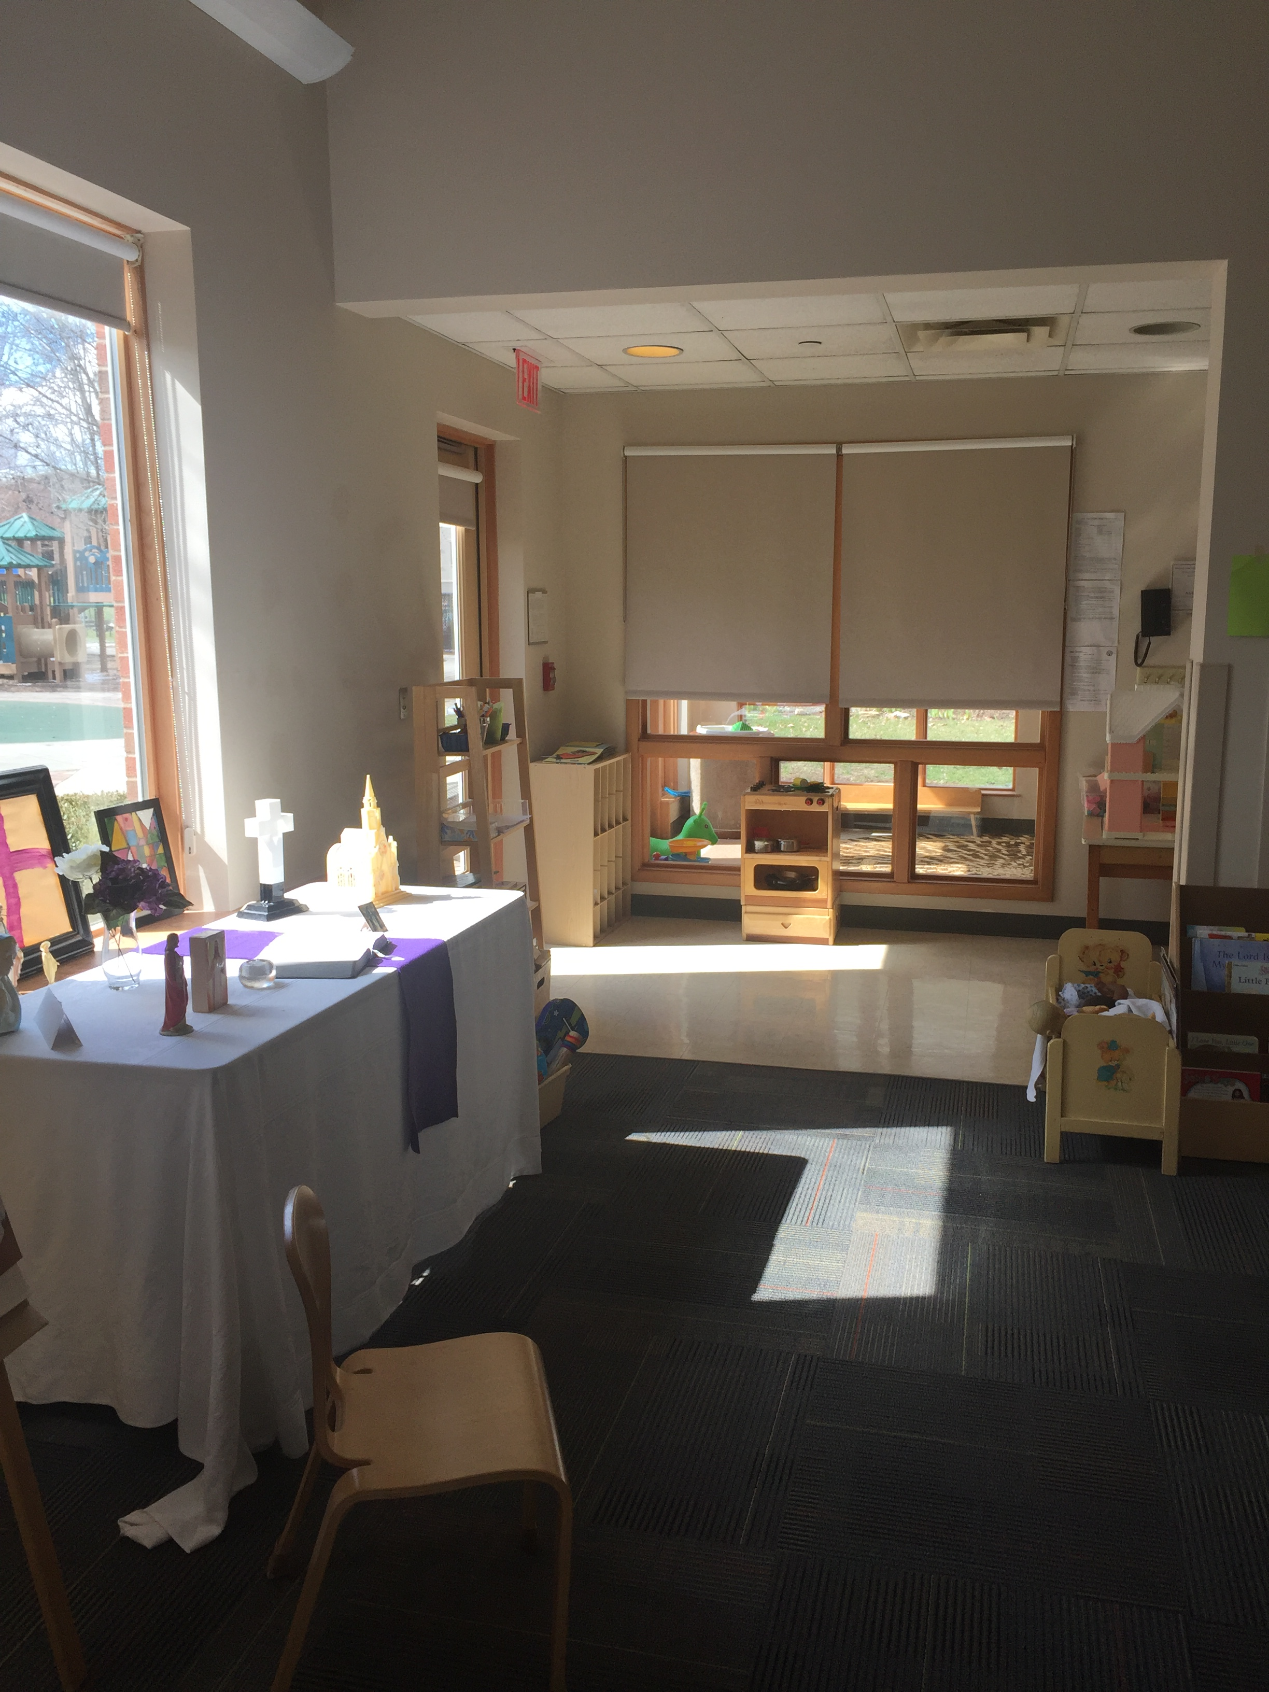
ENVIRONMENT
Classroom set up
Children learn through play and repetition
Enriched environment

Slide 15
REMEMBER:
THE ENVIRONMENT IS THE 3rd TEACHER
IT IS ALWAYS EVOLVING!

Slide 16
LEARNING AREAS
ART
DRAMATIC PLAY
BLOCKS
Creating an
MUSIC
PRAYER TABLE
ENRICHED
NATURE BASED
BOOKS
Environment that shows God is Everywhere
SENSORY

Slide 17
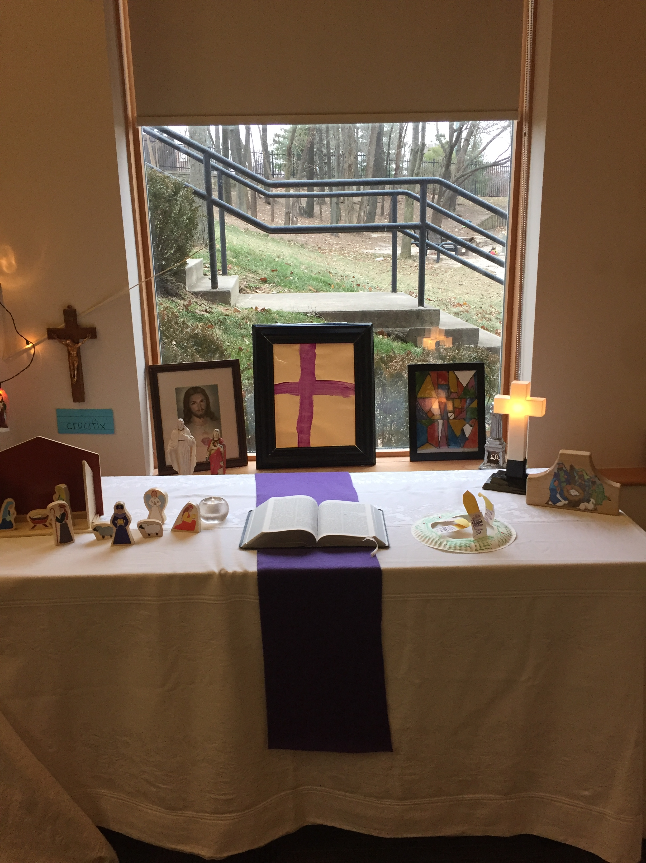
PRAYER TABLE

Slide 18
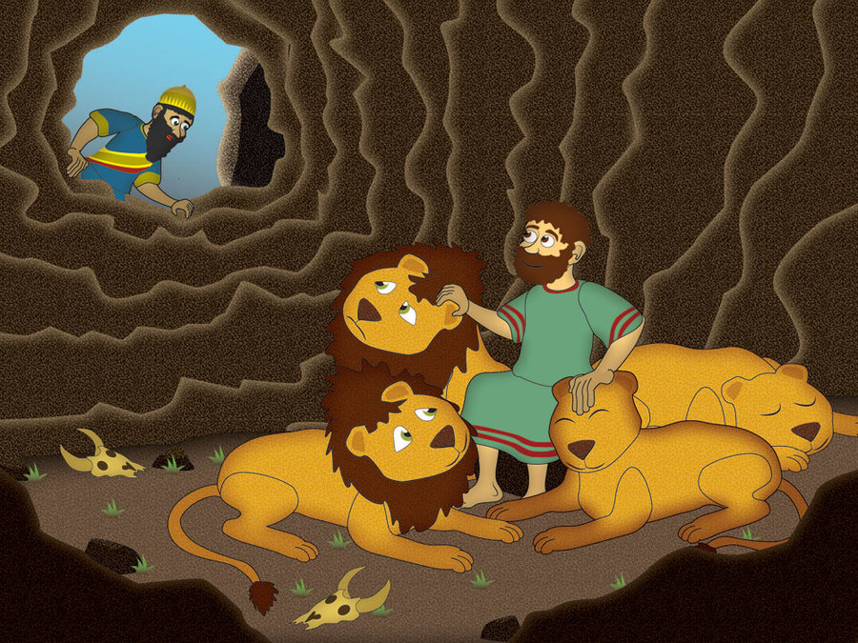
CONTENT
Ensure content/stories are appropriate.
Young children have difficulty distinguishing fact from fantasy. Their fear is real and cannot serve as a foundation upon which faith is built.
Make connections
Tie experiences to their personal life.

Slide 19
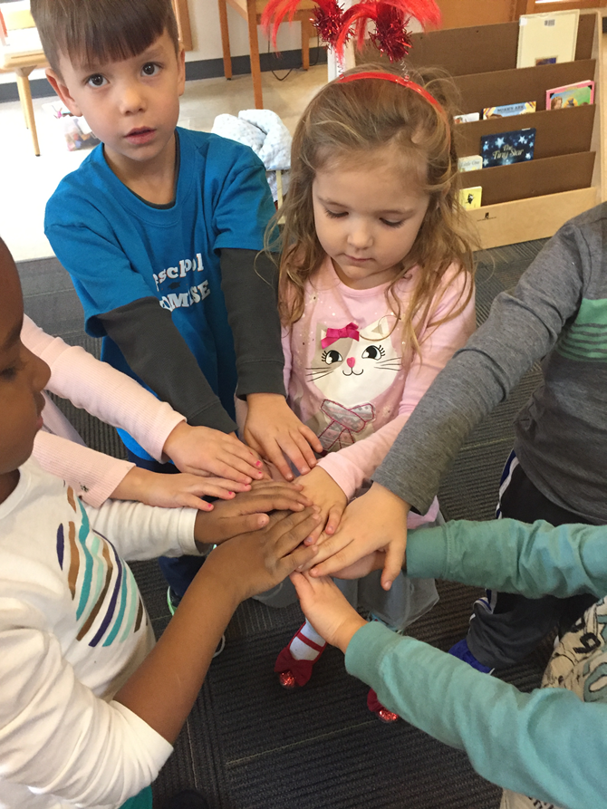
COMMUNITY
Community building activities by:
Living our faith
Serving people in community
Friends:
What is a friend?
Is Jesus a friend?

Slide 20
A DAY IN A PRESCHOOL FAITH FORMATION CLASSROOM

Slide 21
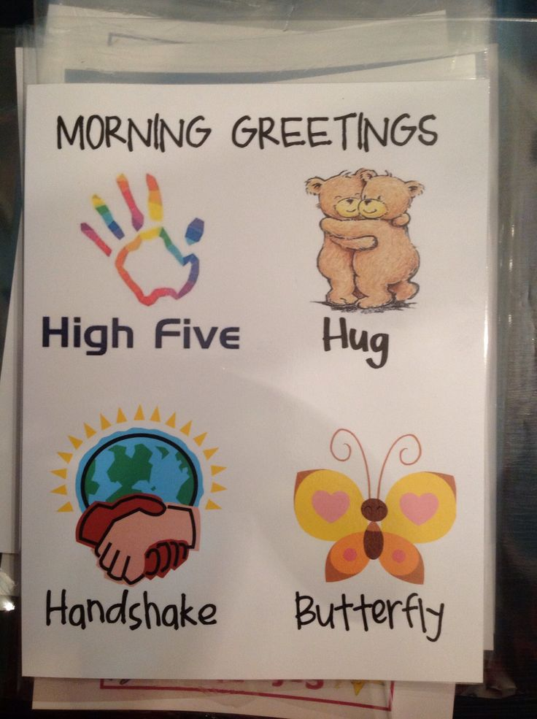
GREETING CHILDREN
Making connections with each child when they enter the classroom
Conscious Discipline
Time to explore the space

Slide 22
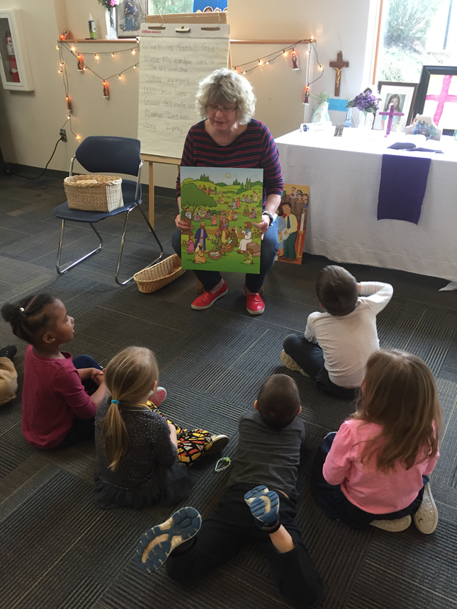
STORY/PRAYER TIME
Gather the Children
Transition
Stories from the Bible
REMEMBER:
Attention span of a preschooler is 8-10 minutes

Slide 23
Examples
of Playscapes

Slide 24
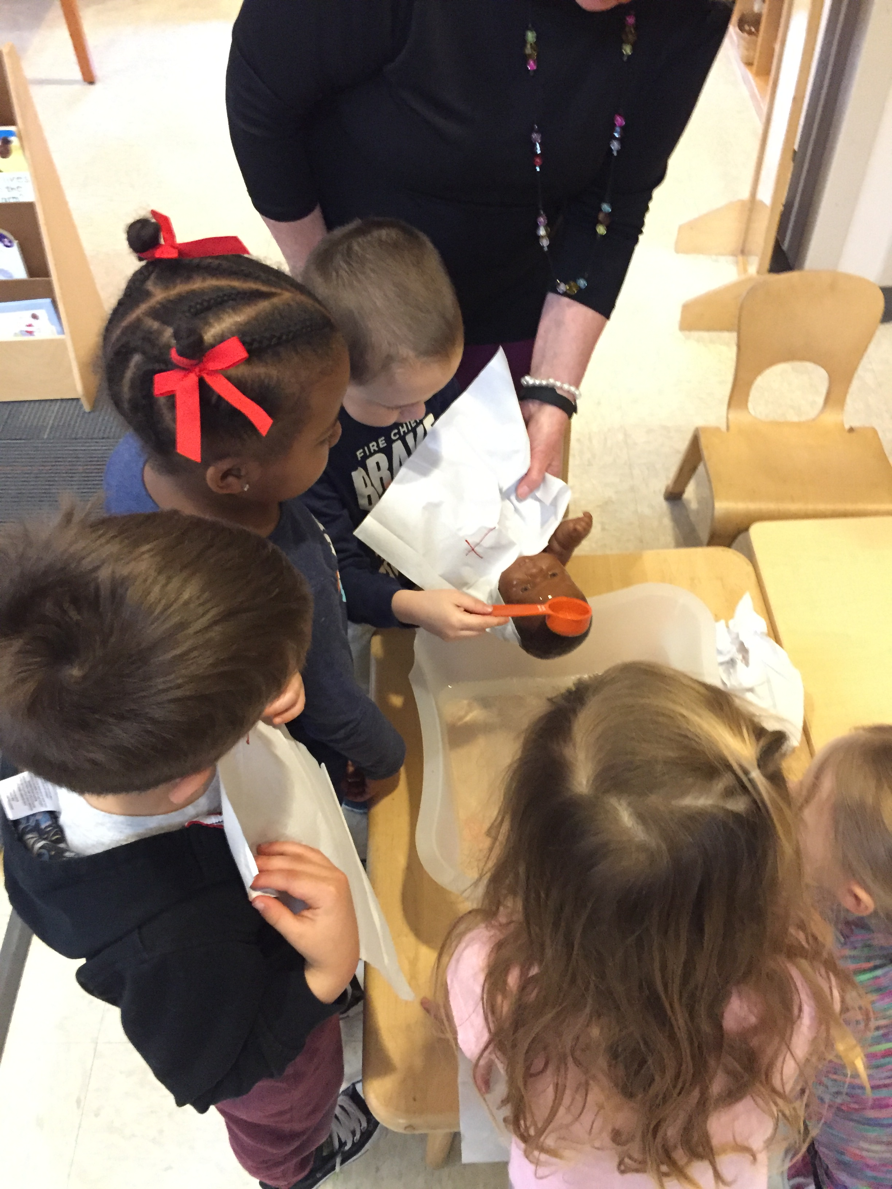
BAPTISM

Slide 25
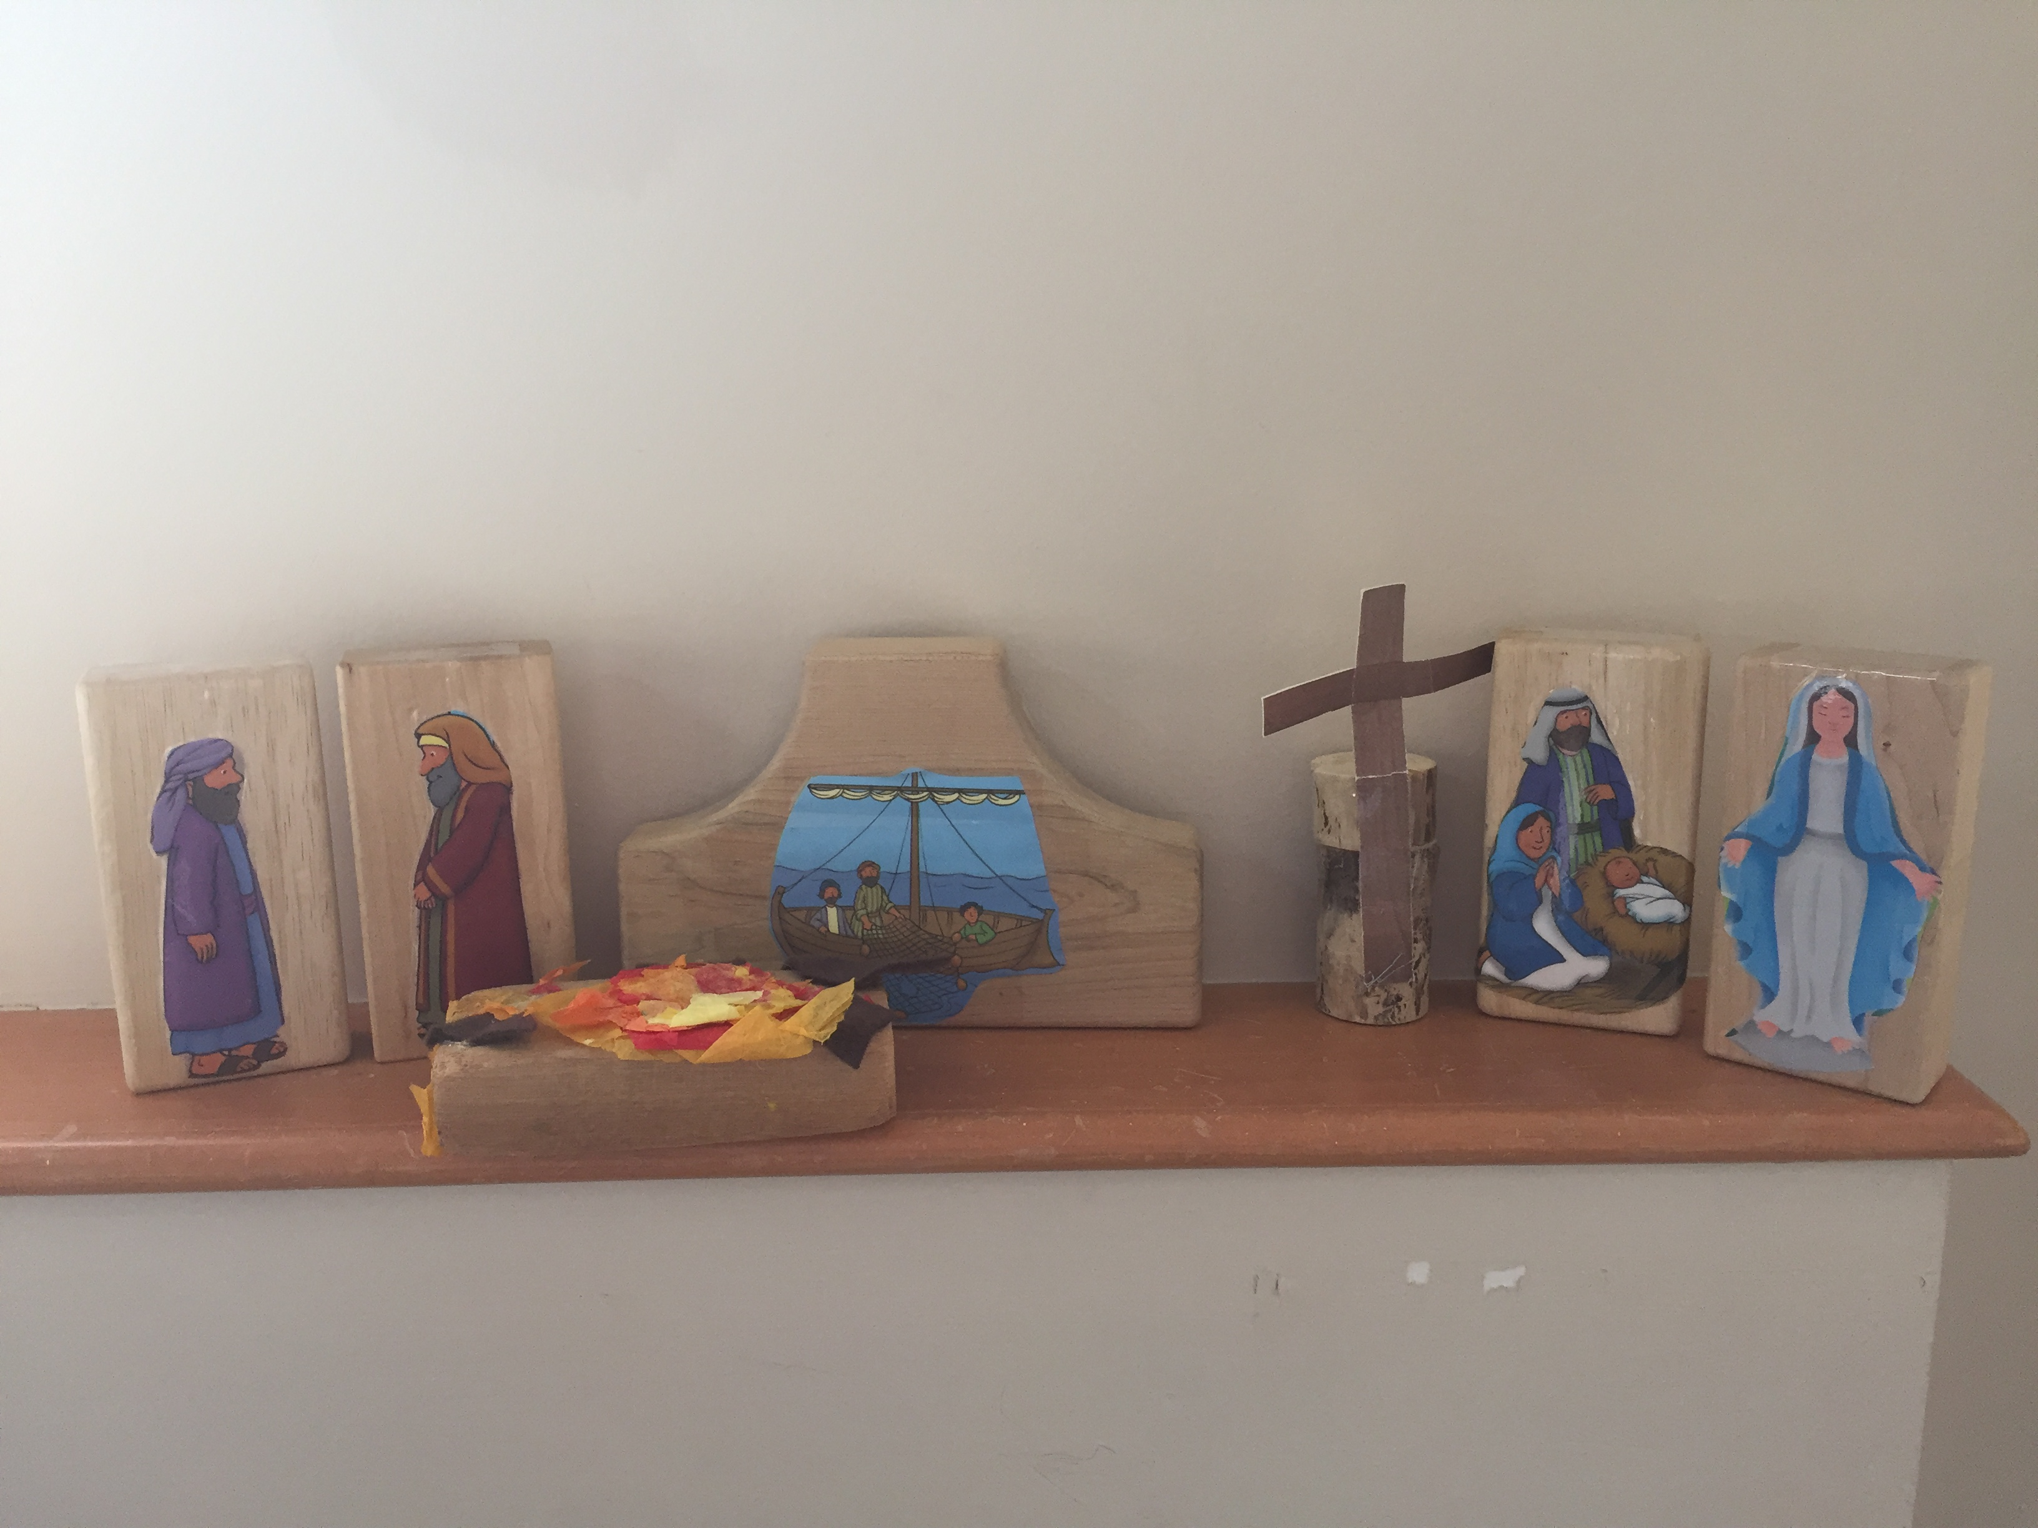
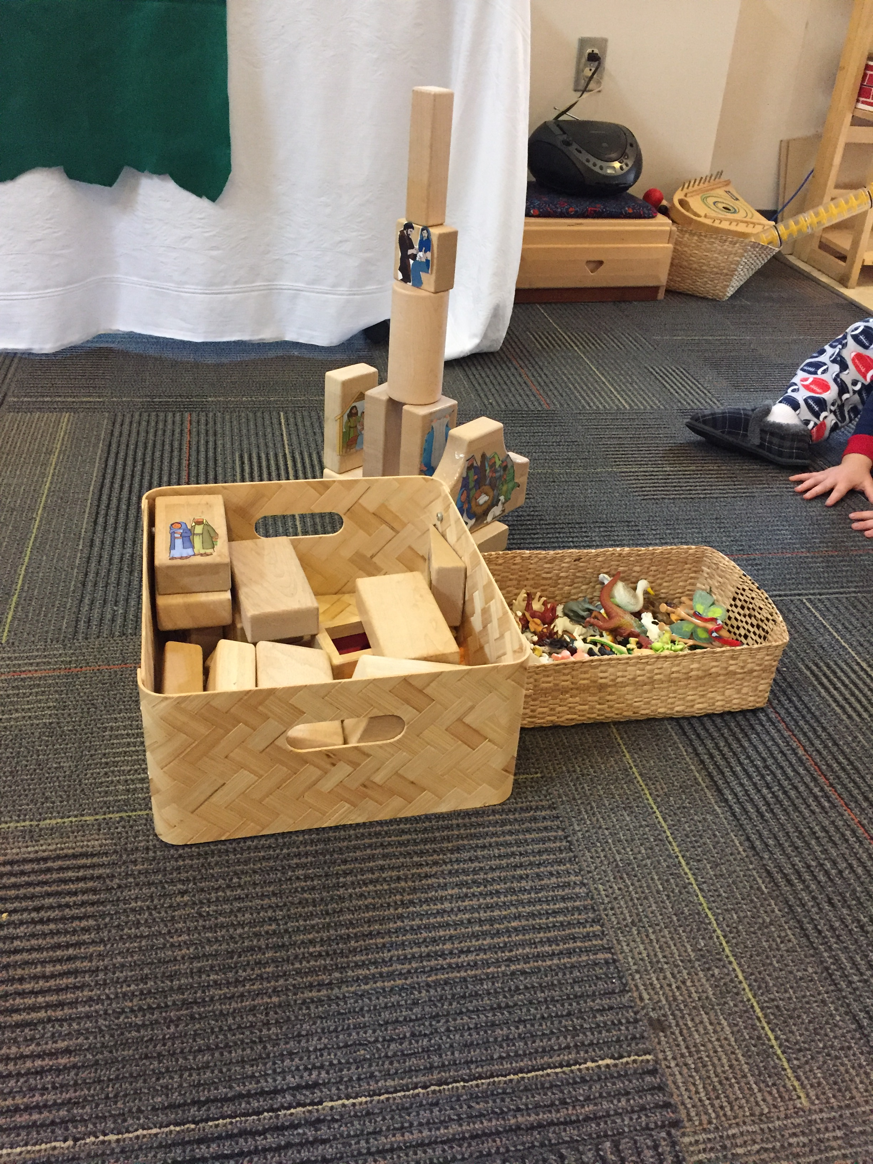
BLOCKS

Slide 26
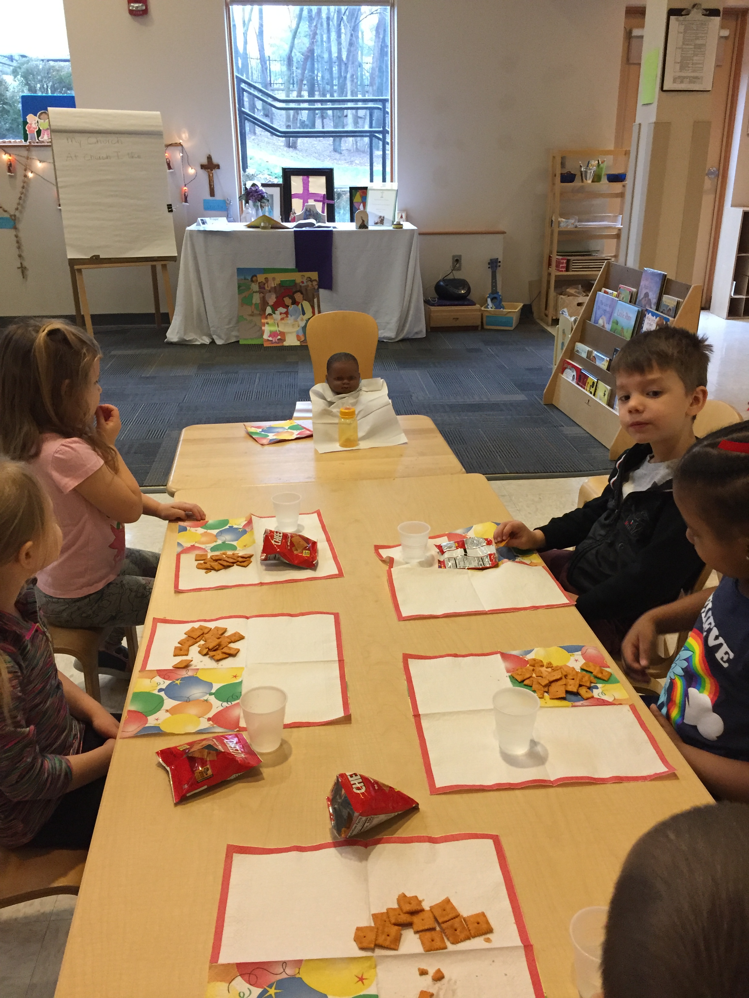
ADVENT/CHRISTMAS

Slide 27
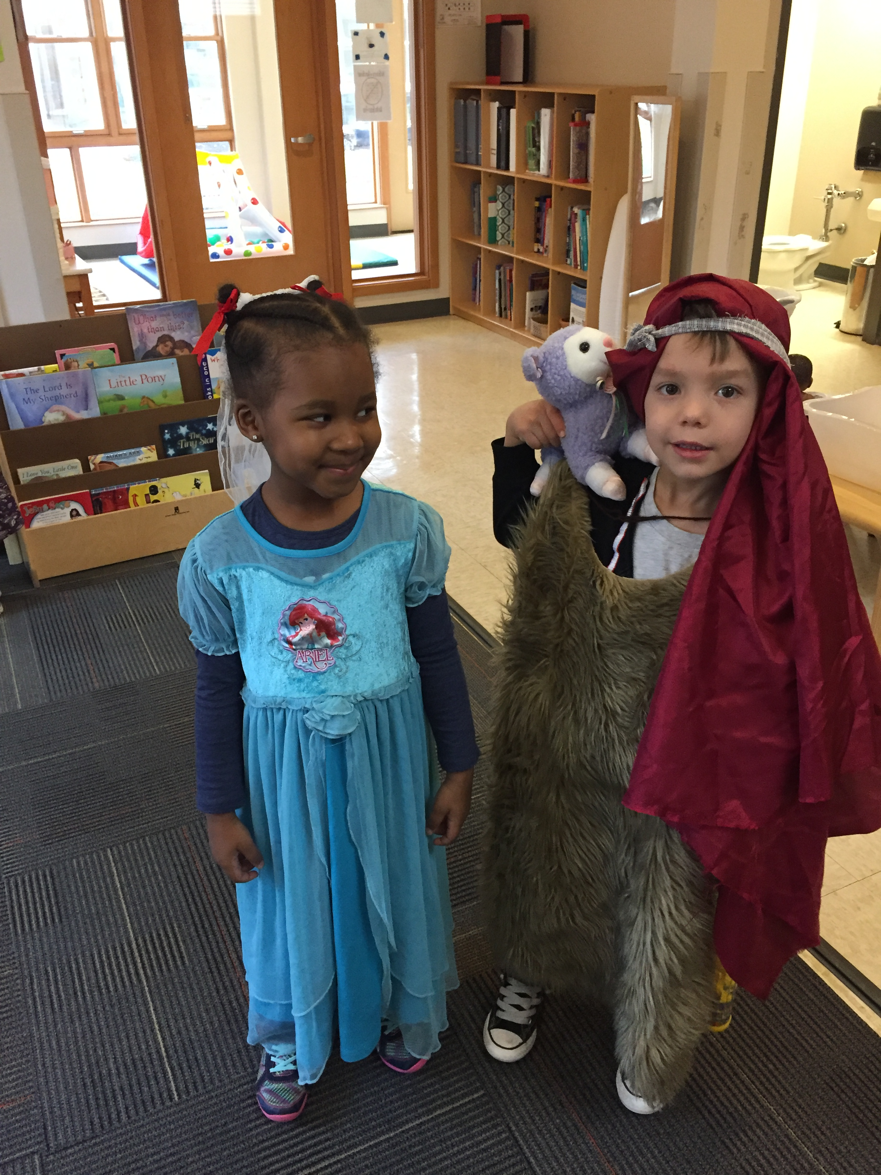
THE PARABLE OF THE LOST SHEEP

Slide 28
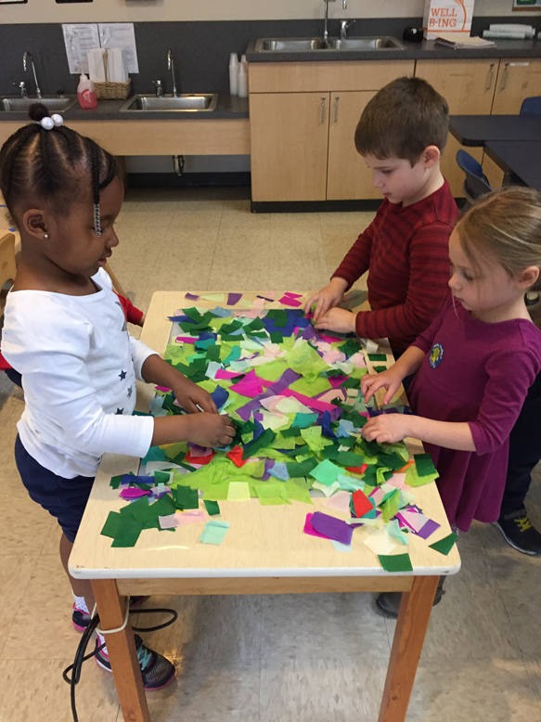
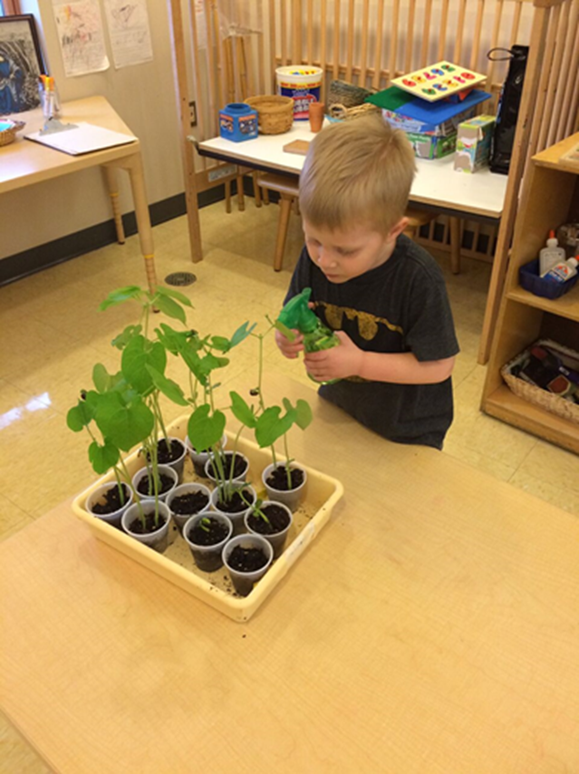
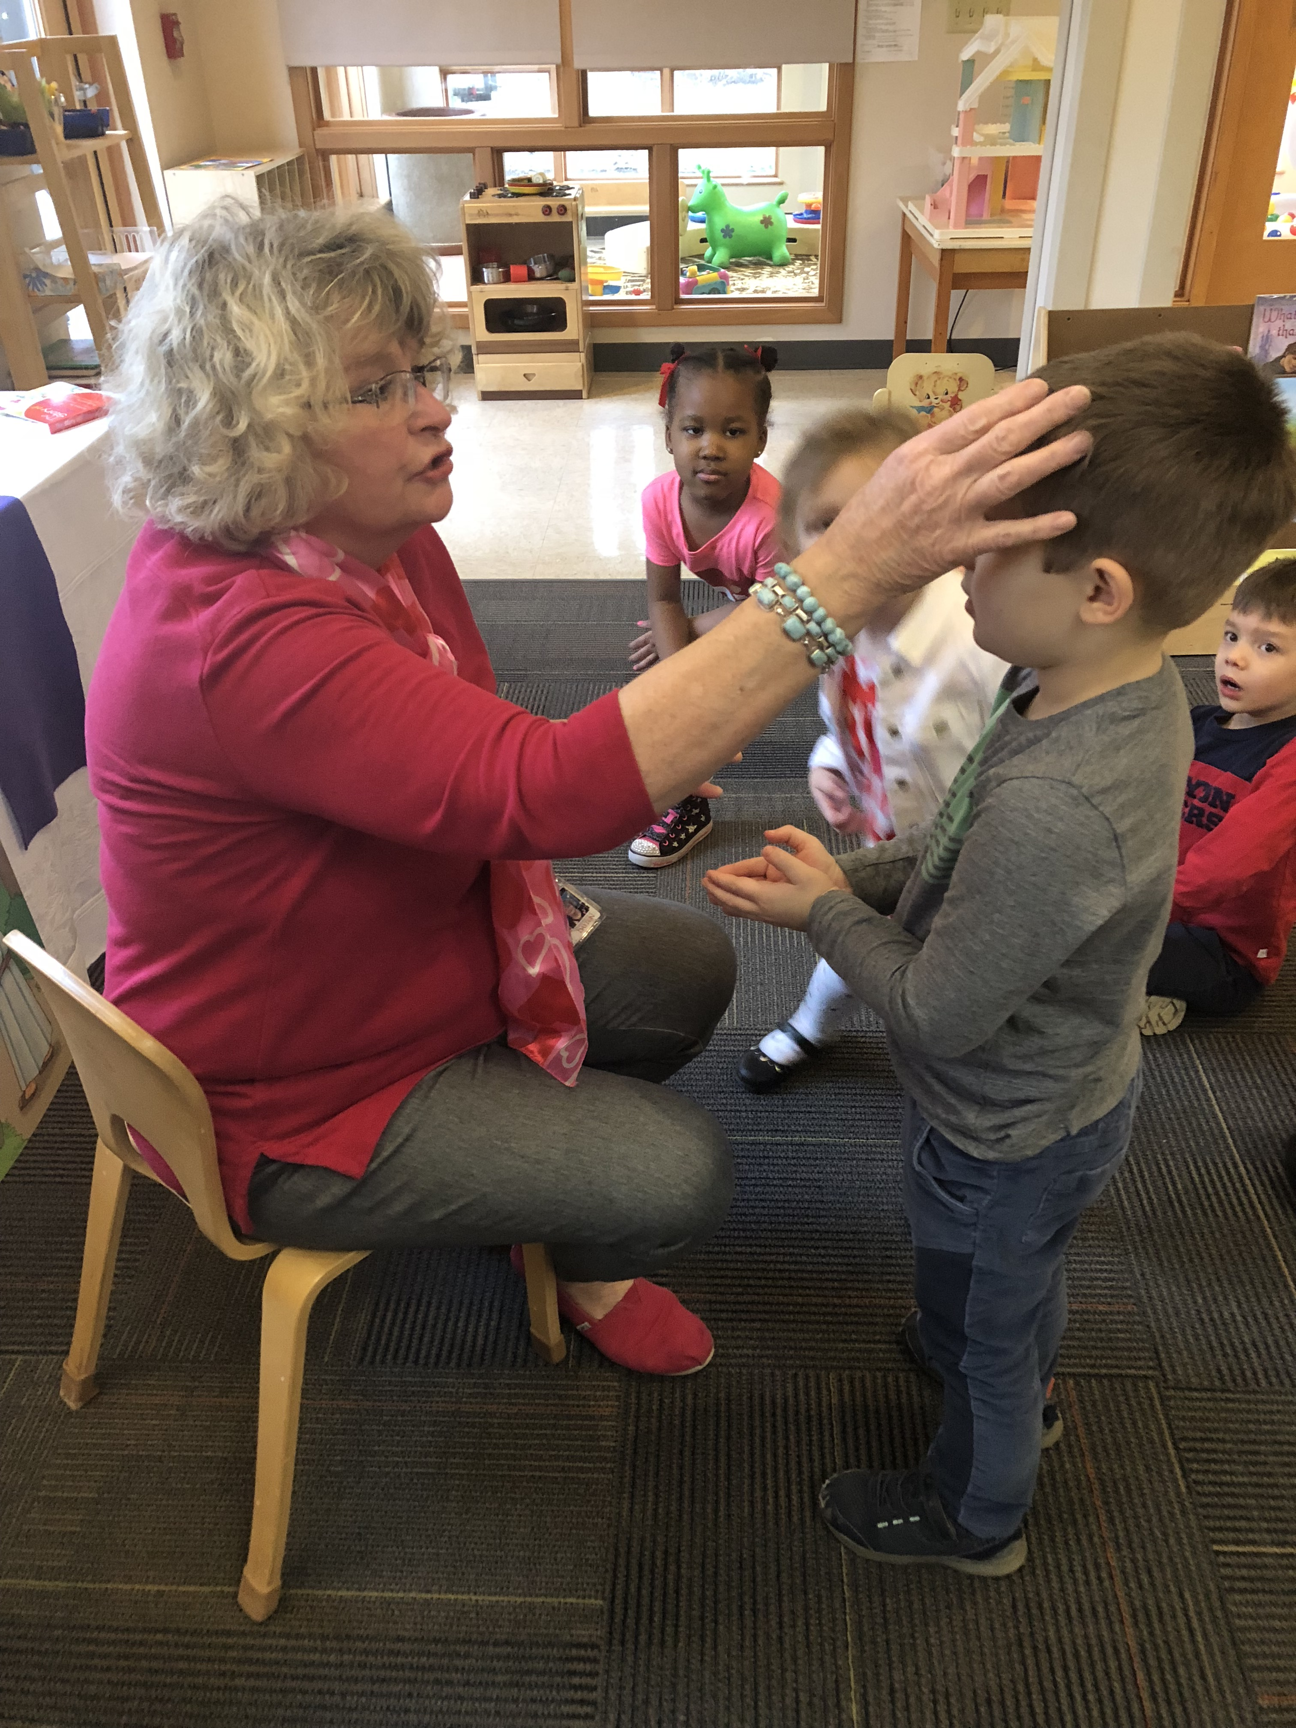
LENT/EASTER

Slide 29
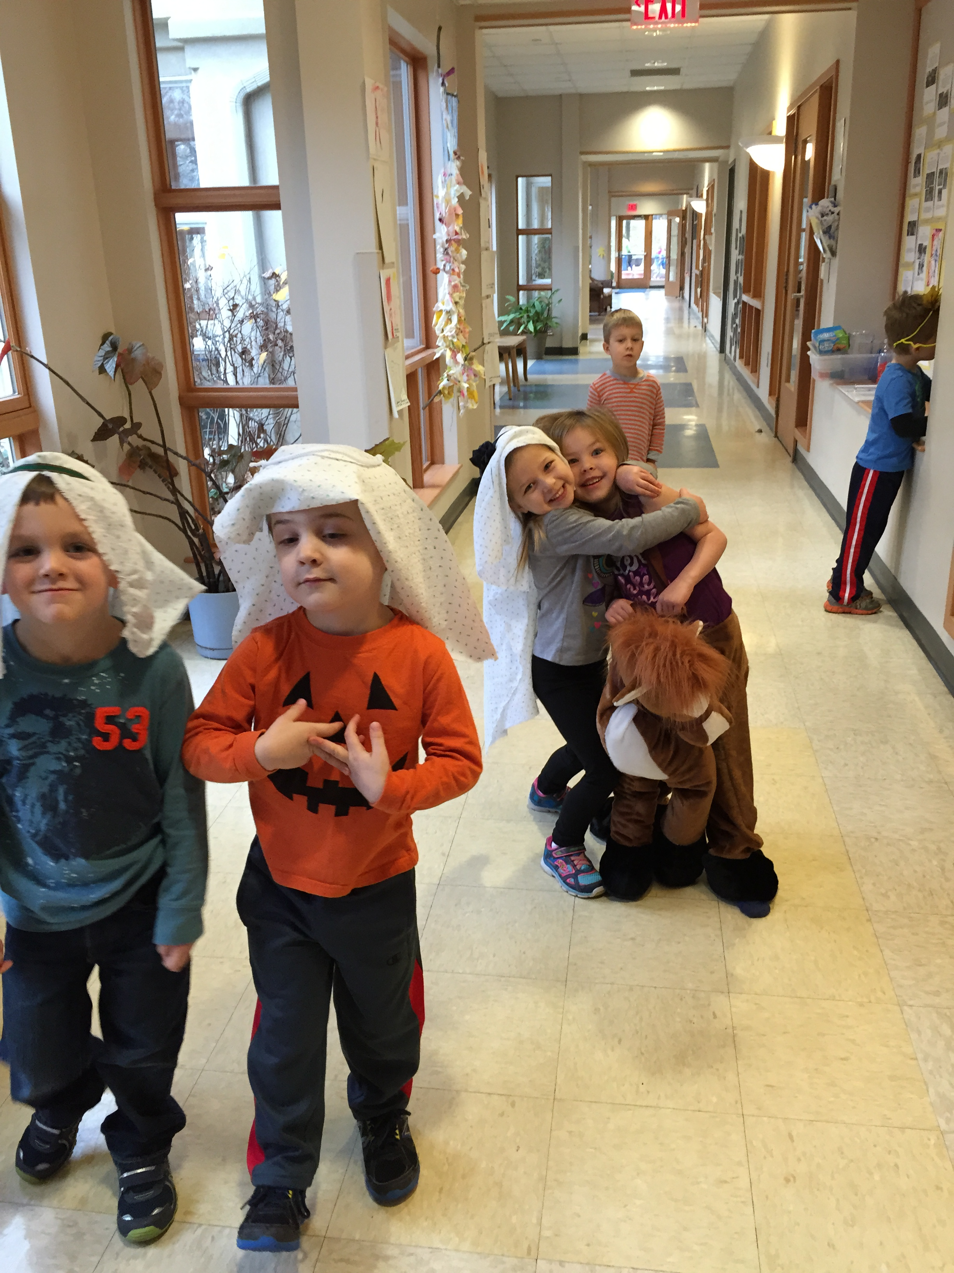
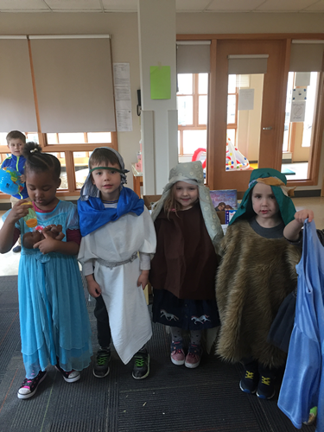
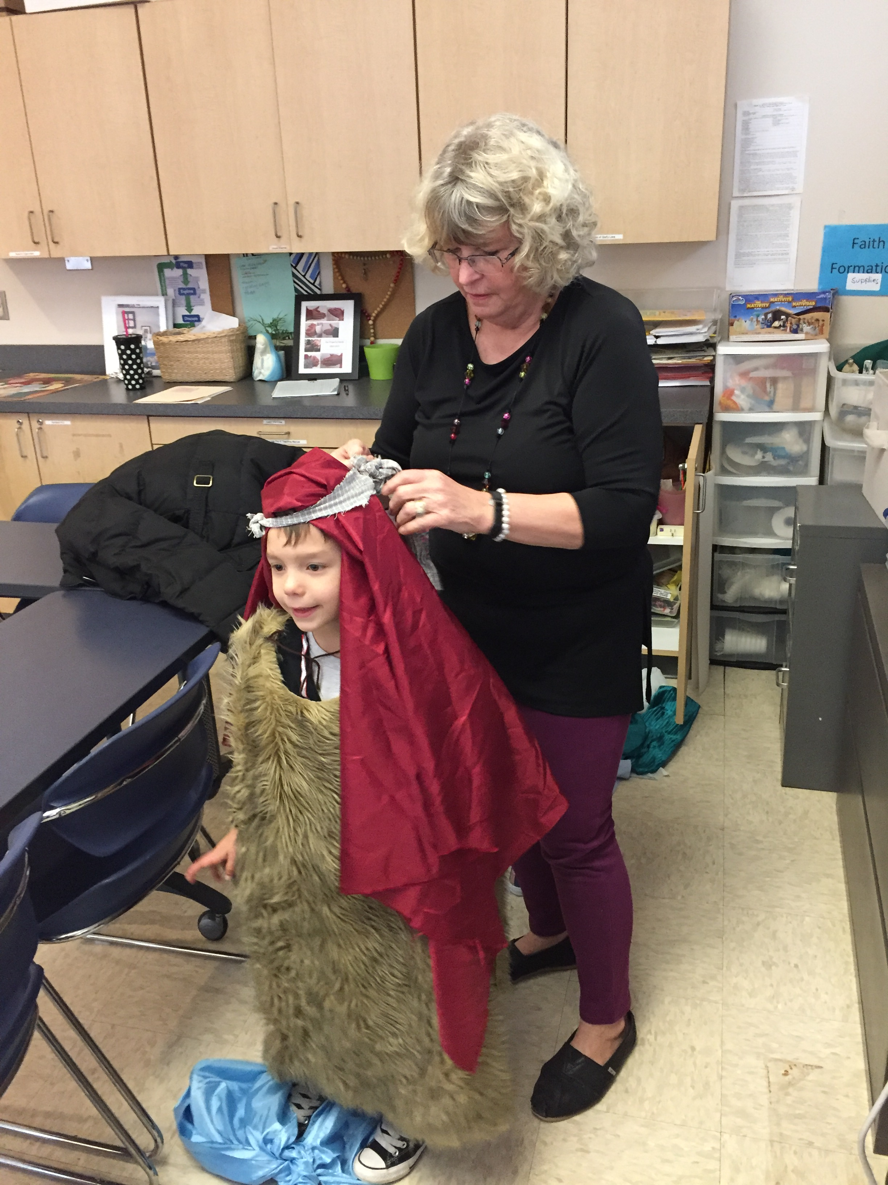
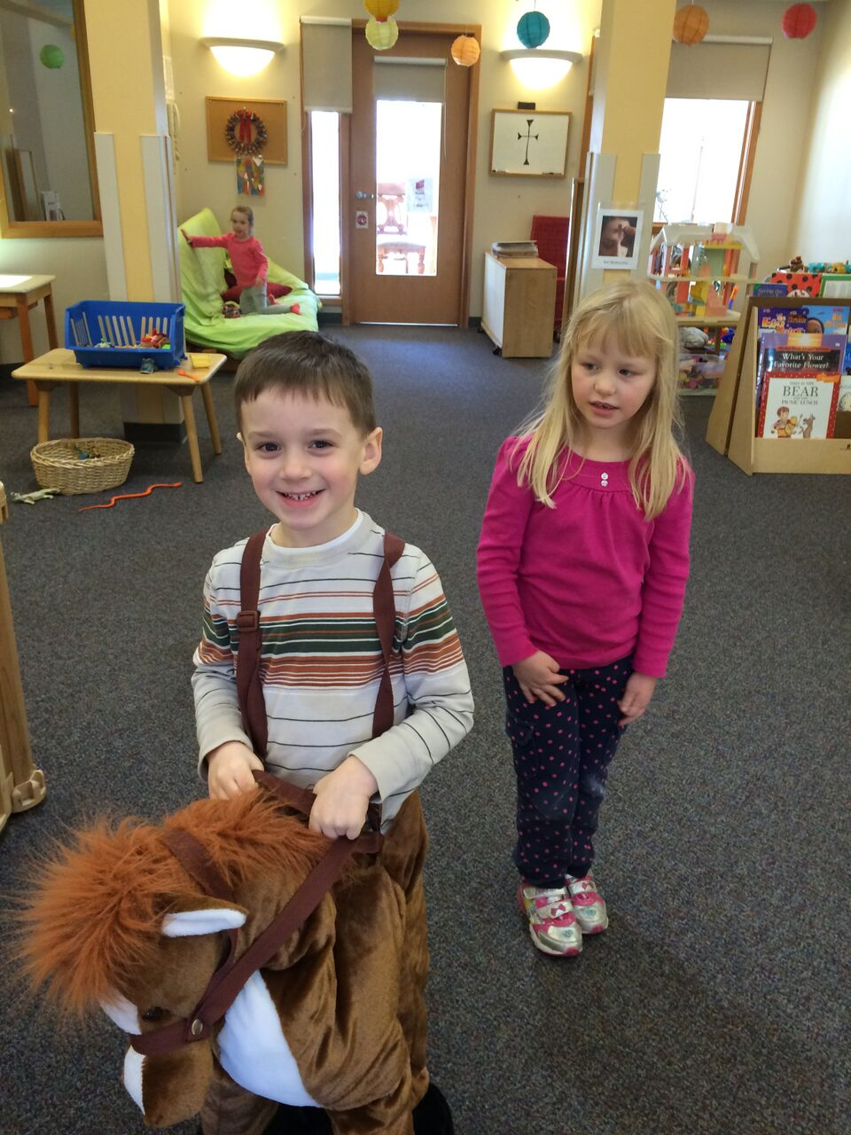
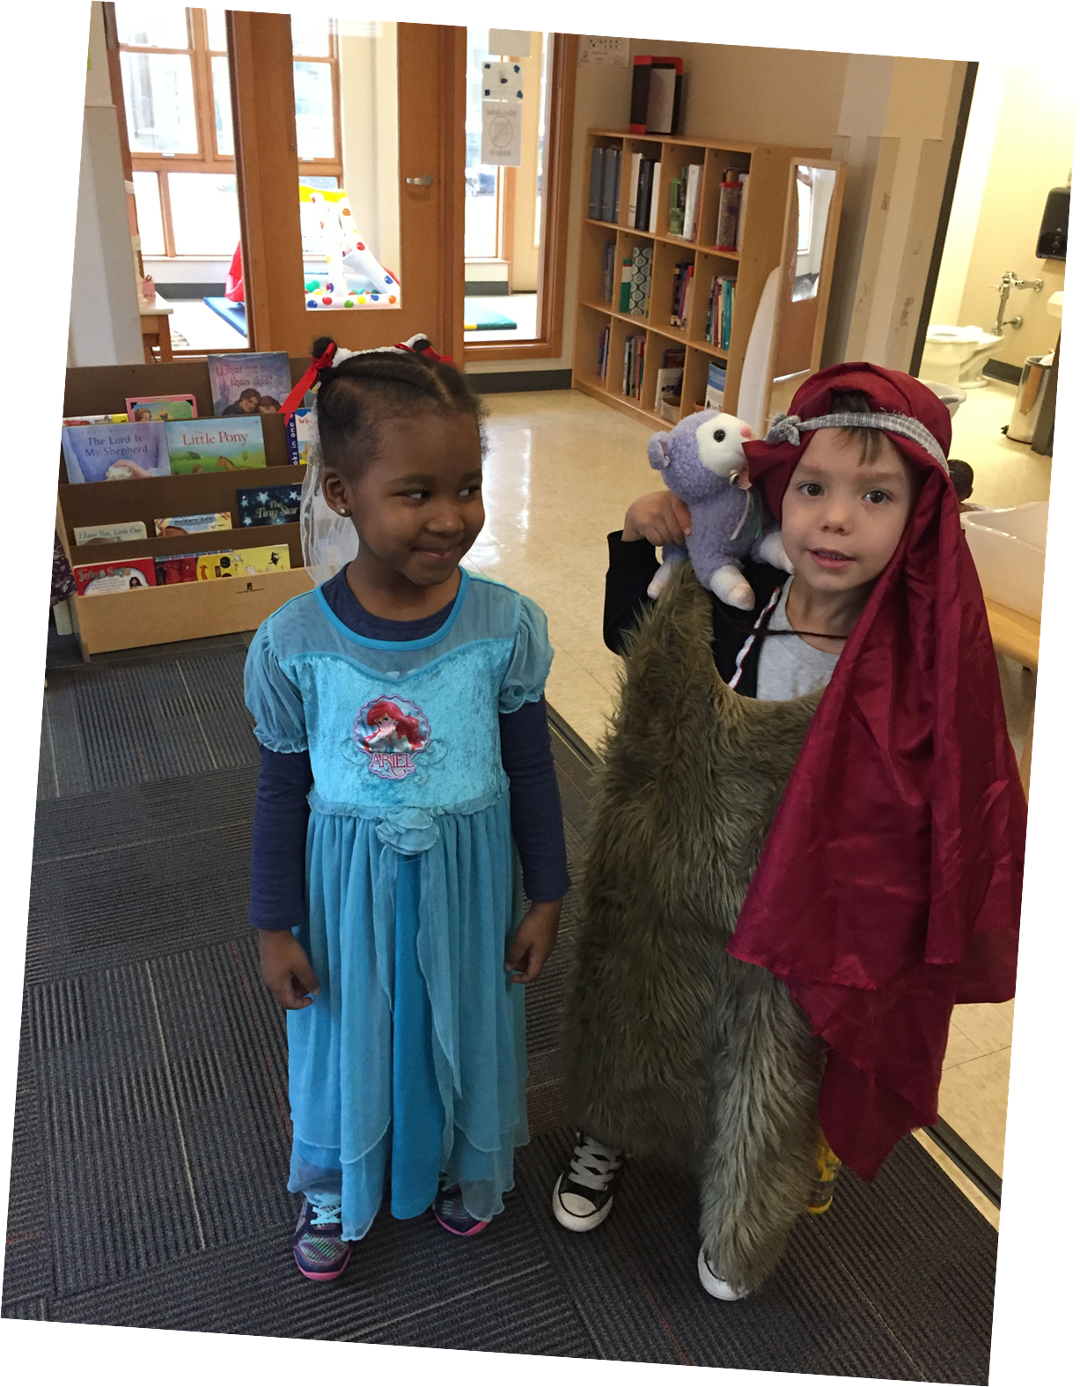
DRAMATIC PLAY

Slide 30
CLOSING PRAYER
Come together just as we started
Recollect
Transition
Song
Prayer and Cheer

Slide 31
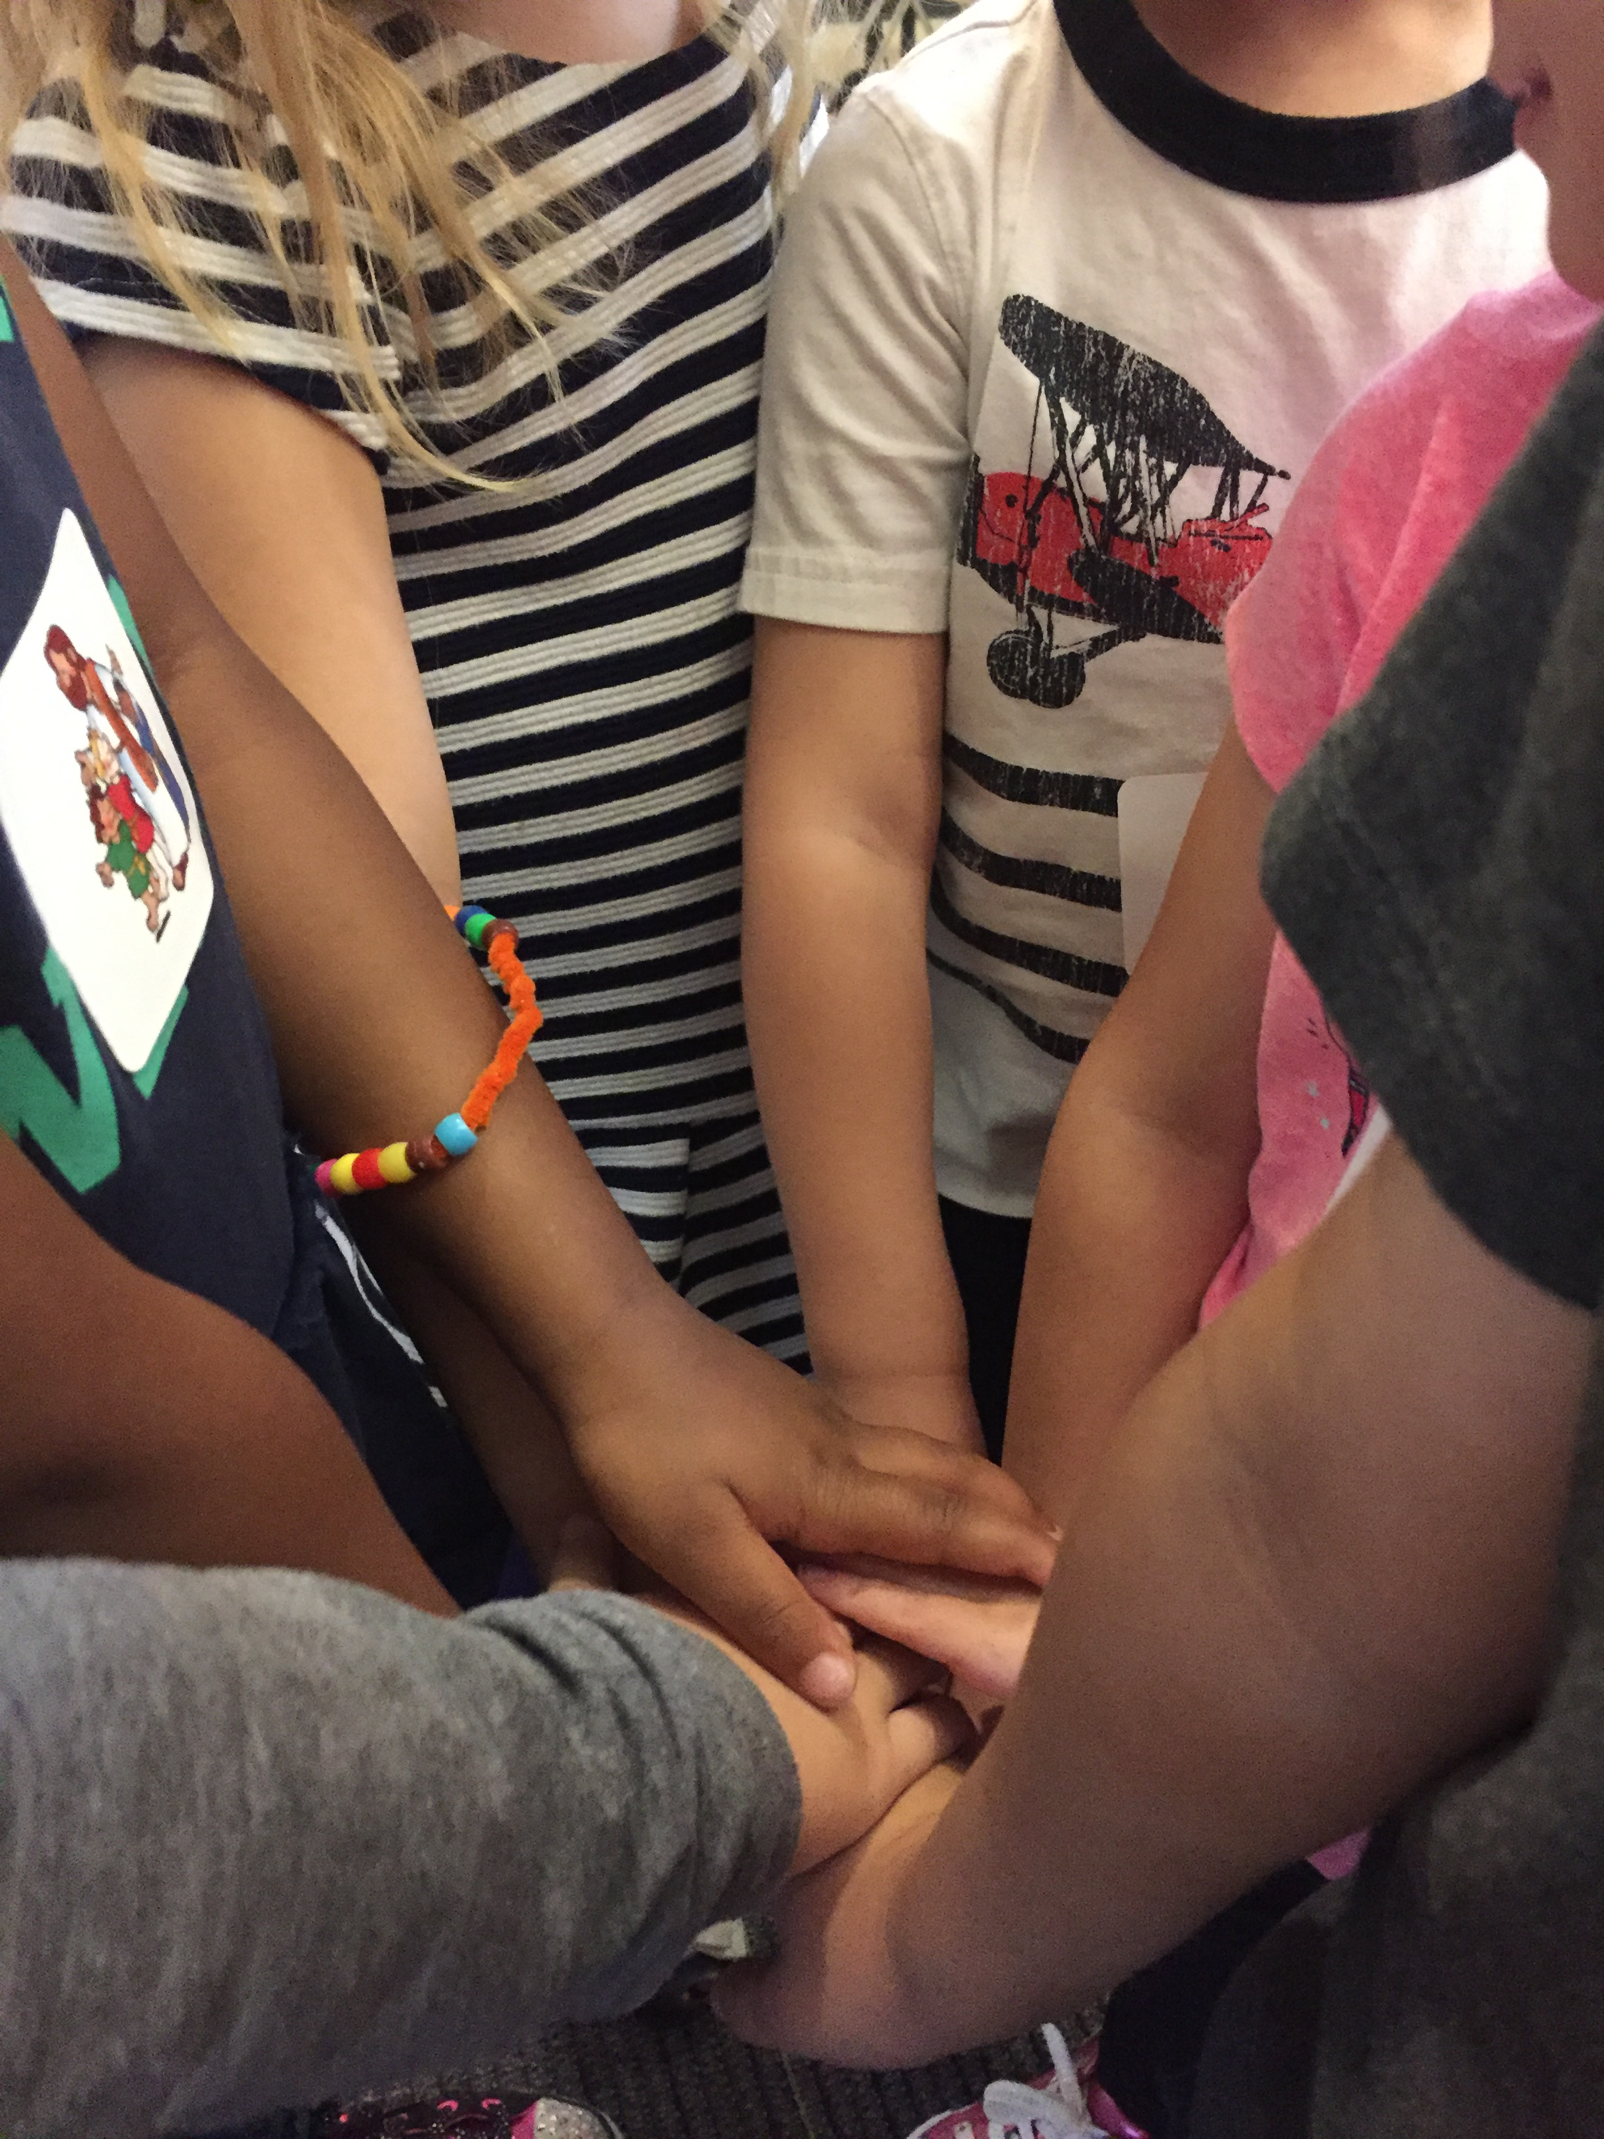
GOD IS GOOD!

Slide 32
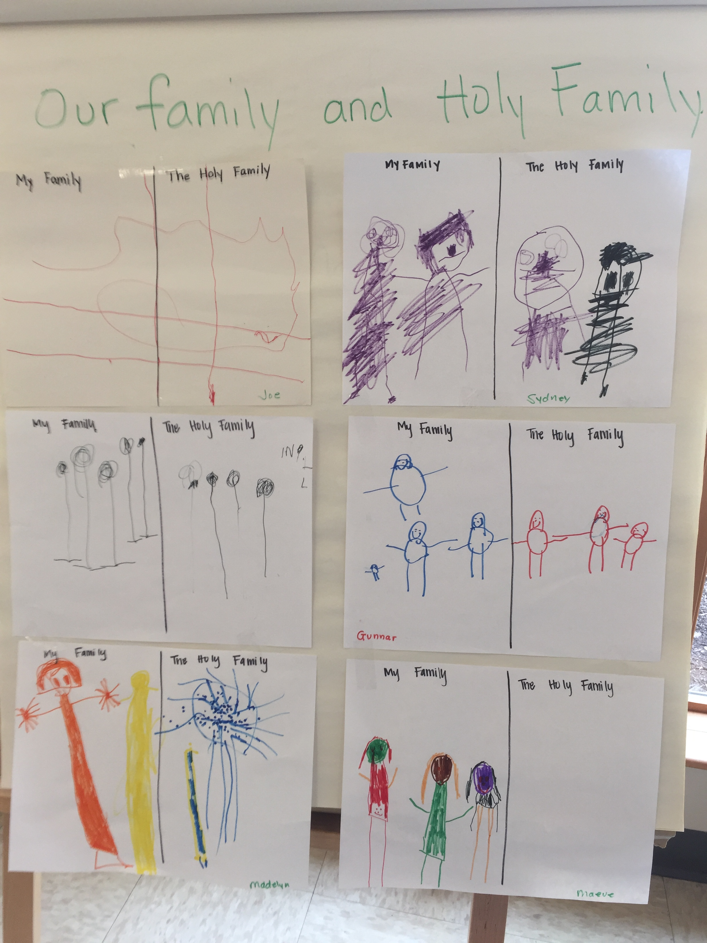
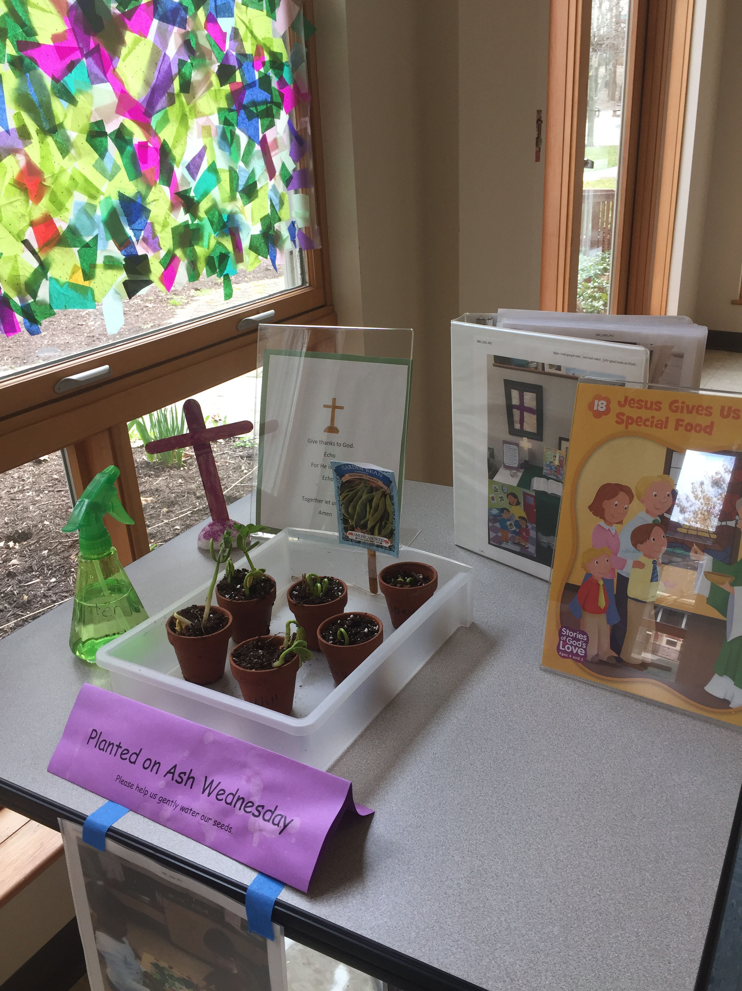
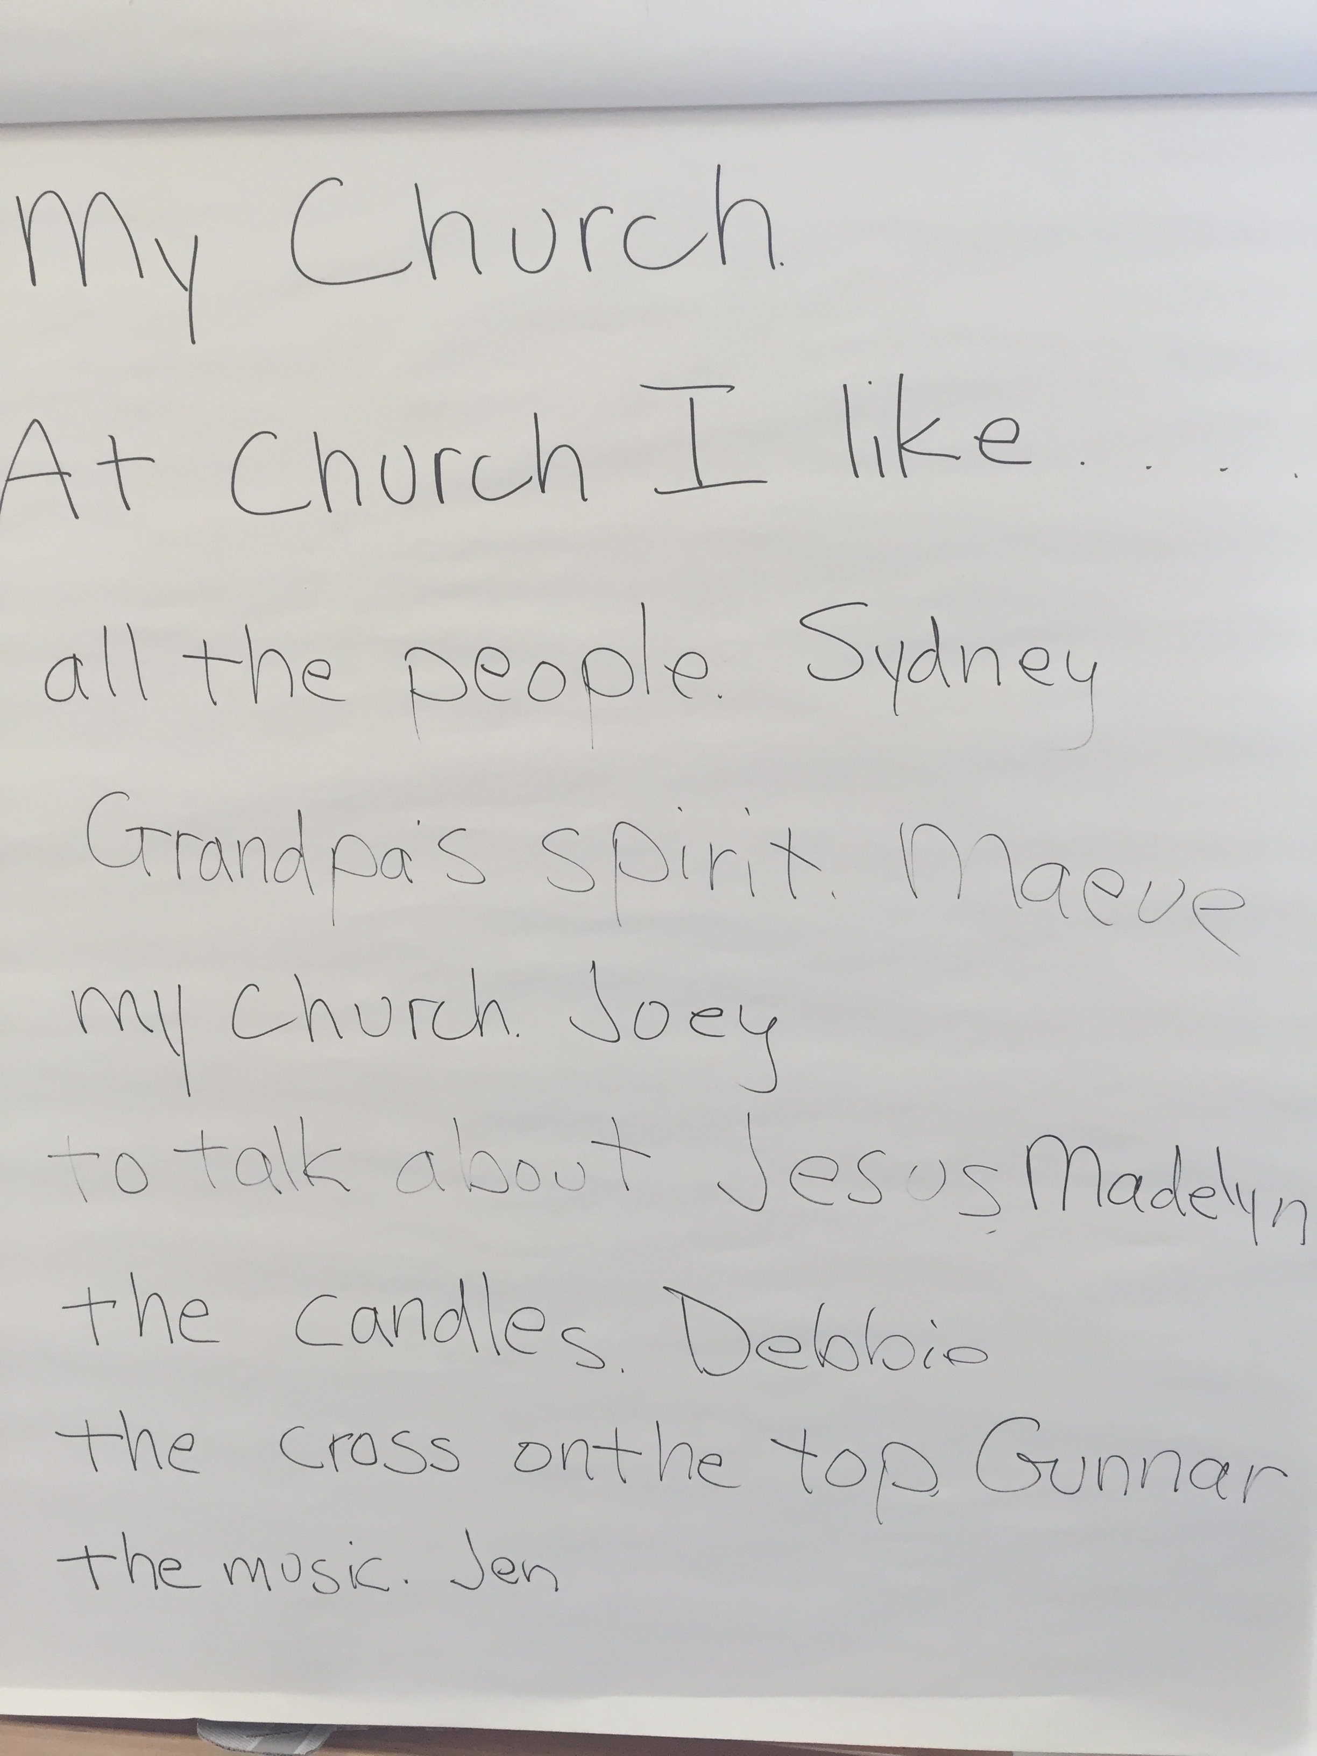
FAMILY ENGAGEMENT

Slide 33
RESOURCES

Slide 34
LESSON TIPS

Slide 35
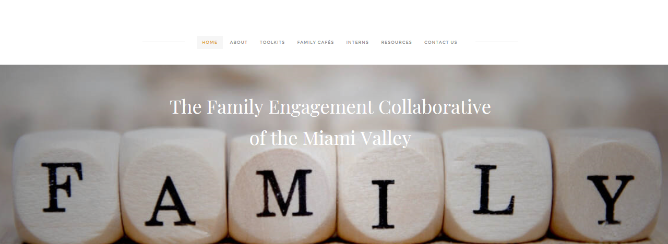
FAMILY ENGAGEMENT
INCLUDES TOOLKITS/RESOURCES FOR FAMILIES
& CATHOLIC PARENTING RESOURCES

Slide 36
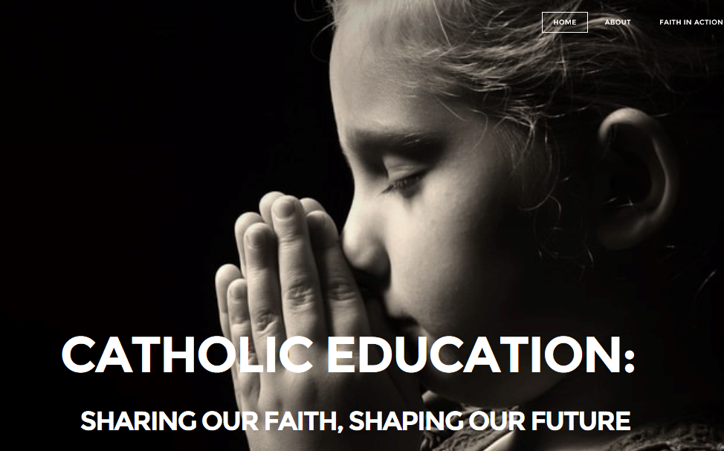
FAITH-BASED EARLY CHILDHOOD

Slide 37
ACTION PLAN
IDENTIFY AN IDEA FROM THIS SESSION THAT YOU CAN USE IN YOUR SETTING.
DESCRIBE WHAT YOU PLAN TO DO.
PROVIDE YOUR NAME AND EMAIL AND I WILL CONNECT WITH YOU IN 4 WEEKS TO SEE HOW YOU DID.

Slide 38
QUESTIONS?

Slide 39
CLOSING
PRAYER

Slide 40
CONTACT
Debbie Poppaw
dpoppaw1@udayton.edu
937-229-2158

Slide 41
GOD IS
GOOD

